Slide 1
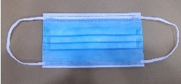
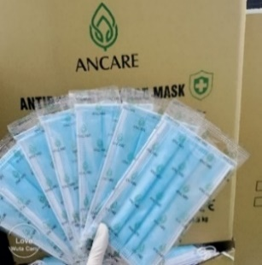
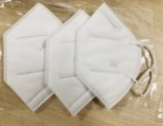
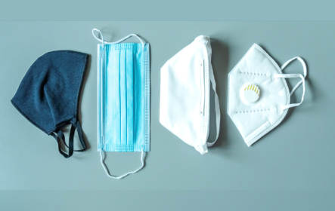


FACE MASKS
3 ply & 4 ply face masks, Levels 1,2,3 non sterile, biodegradable – PP, 95%-99% BFE & PFE
3 ply & 4 ply mace masks, Level 3, Sterile with ear loops
and long ear lines
N95 with and without valve
Fabric Bamboo antibacterial masks
Children’s face masks
Terms & conditions apply
Orders – Though MOQ’s apply, smaller
orders accepted on availability of stock
Standard : Level 1 to 3, EN 14683 Type 1,11,11R, TGA, CE, FDA, ISO, Test reports, CFS
In partnership with
Shark tower 3rd floor
29, Nguyen Van Mai Street, Ward 8
District 3, Ho Chi Minh City
Tel : +84933296202
Tel : +94776331147 (whatsapp/viber)
Email : Marguerite.Aluwihare@net-glo.com
www:Net-Glo.com
3, Greenslope Street,
Wentworthville NSW 2145, Australia
Tel : +61469049451
Email : panjan.navam@gmail.com

Slide 2
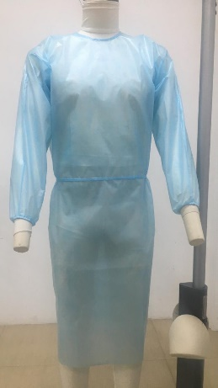
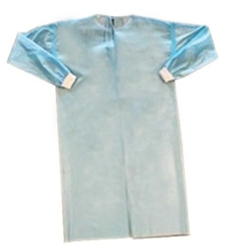
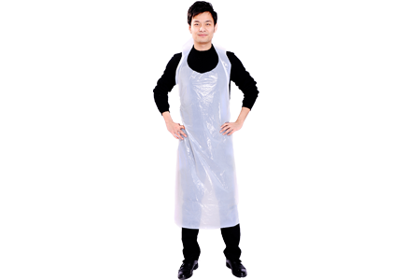
SURGICAL GOWNS, ISOLATIONS GOWNS & PROTECTIVE SUITS
PP – non woven fabric, disposable & bio degradable, Anti static & non-linting, dust proof, antibacterial and water proof
Colours – Blue / White
Material – 35 gsm to 60 gsm PP fabric
SMS : Spun bound/melt blown/spun bound ,
PPPE: Polyester, Polypropylene with quoting
SIZES : M/L/XL/XXL
AAMI Level 1,2,3 , AATCC TM127-2018:>20cm H20
AATCC TM42-2017ePB70AMI L2
Also available in PE, disposable Aprons & gowns
Terms & conditions apply
Orders – Though MOQ’s apply, smaller
orders accepted on availability of stock
Standard : EN 14126, ISO 13485:2016, ISO 9001:2015, TGA, FDA, CE, Test reports, CFS
In partnership with
Shark tower 3rd floor
29, Nguyen Van Mai Street, Ward 8
District 3, Ho Chi Minh City
Tel : +84933296202
Tel : +94776331147 (whatsapp/viber)
Email : Marguerite.Aluwihare@net-glo.com
www:Net-Glo.com
3, Greenslope Street,
Wentworthville NSW 2145, Australia
Tel : +61469049451
Email : panjan.navam@gmail.com

Slide 3
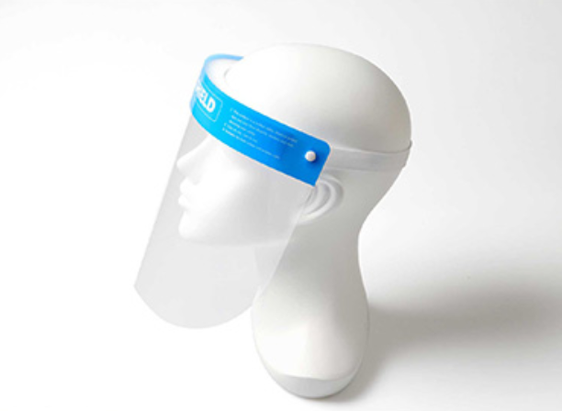
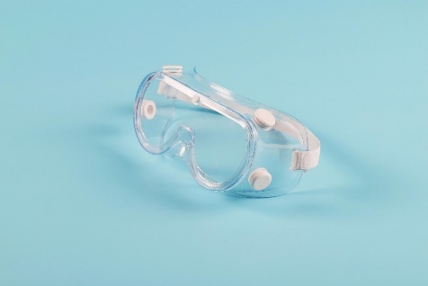
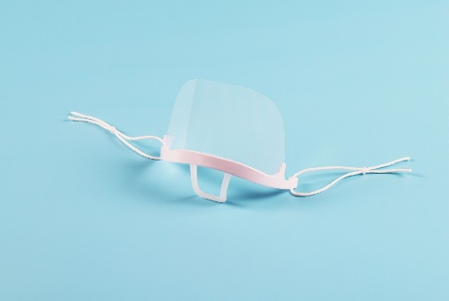
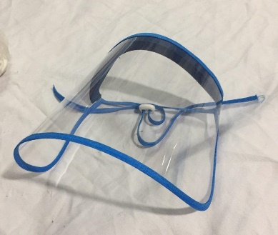
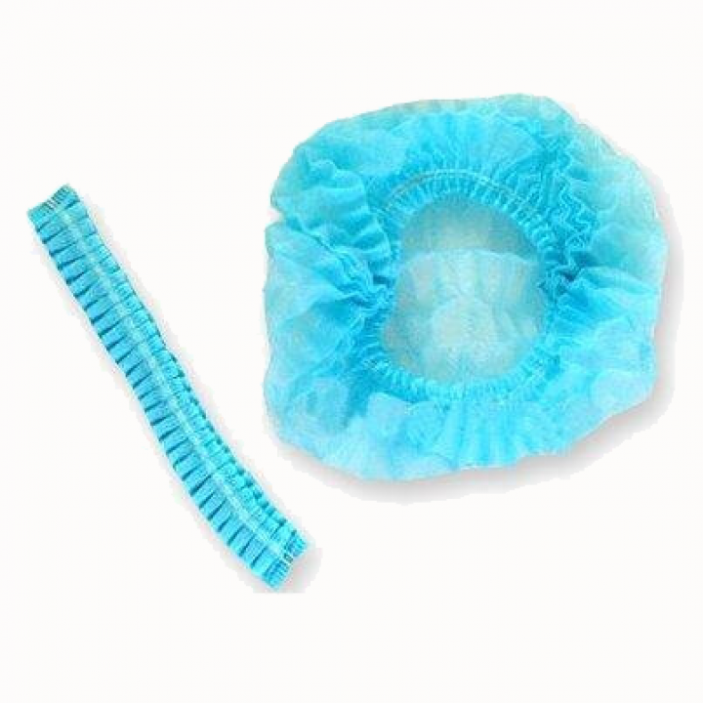
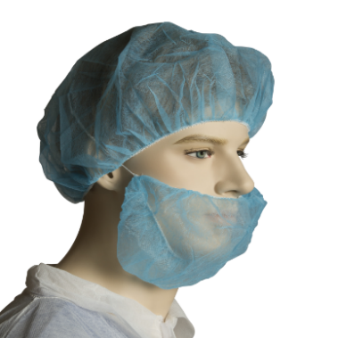
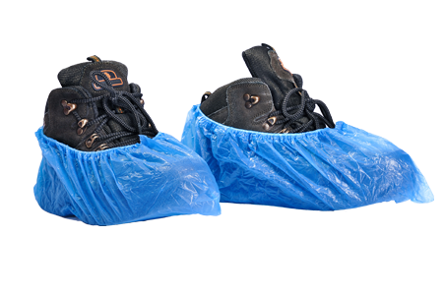
FACE SHIELDS, GOGGLES, MOUTH COVERS, BOUFFANT CAPS, SHOE COVERS, BEARD COVERS
Face shields
Option 1 - Face shields – re-usbable, 100% plastic
Option 2 - Disposable /adjustable face shields:
Apet/Anti fog
Disposable protective goggles
Disposable protective mouth covers
APET 0.3mm anti-fog and ANSI / FDA approved
Terms & conditions apply
Orders – Though MOQ’s apply, smaller orders accepted on availability of stock
In partnership with
Shark tower 3rd floor
29, Nguyen Van Mai Street, Ward 8
District 3, Ho Chi Minh City
Tel : +84933296202
Tel : +94776331147 (whatsapp/viber)
Email : Marguerite.Aluwihare@net-glo.com
www:Net-Glo.com
3, Greenslope Street,
Wentworthville NSW 2145, Australia
Tel : +61469049451
Email : panjan.navam@gmail.com

Slide 4
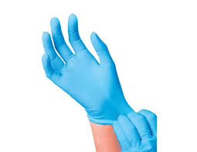
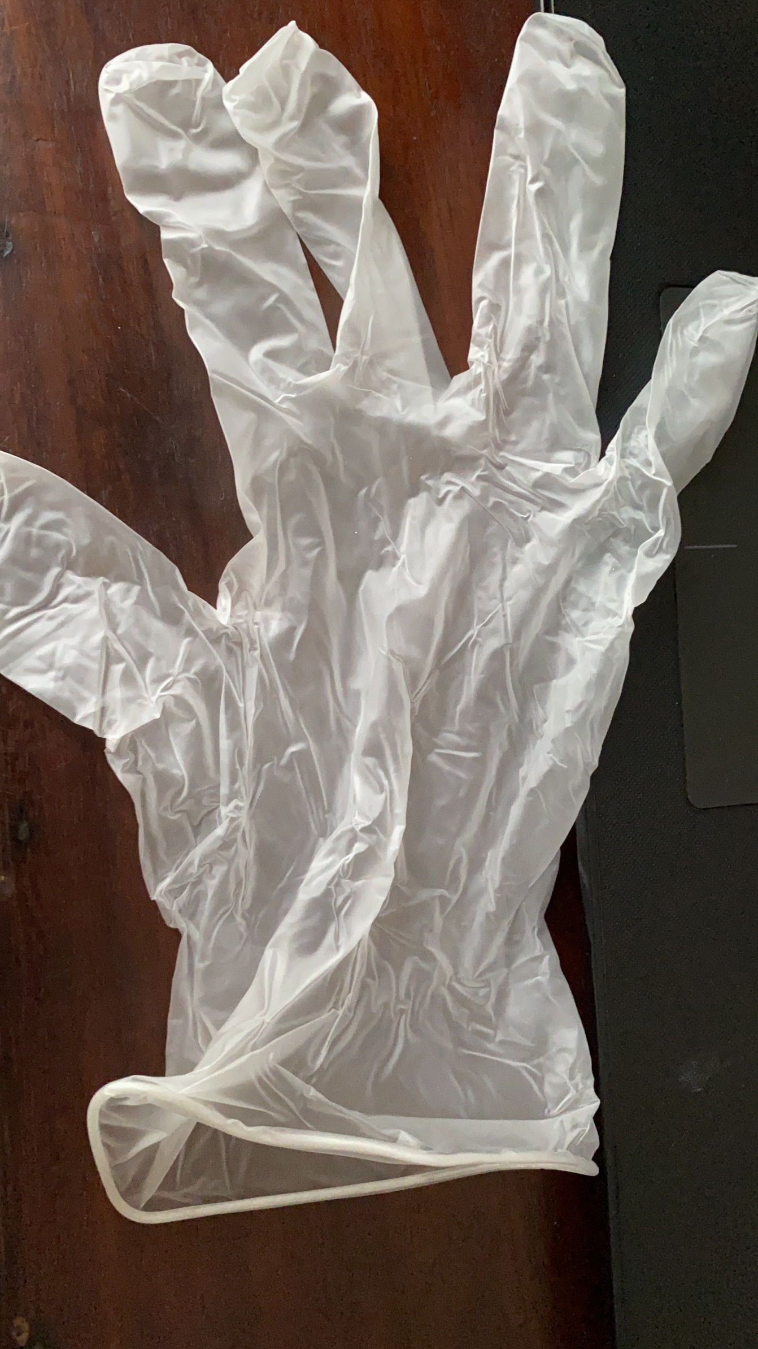
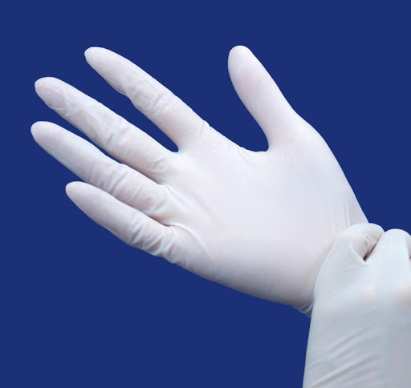
DISPOSABLE NITRILE & VINYL EXAMINATIONS GLOVES
Nitrile
Latex free, Powder free, Powdered, Non-sterile, single use
Standard length 9 inch
Sizes : XS/S/M/L/XL
Blue / Clear
Vinyl
Disposable powder free, powdered
Blue / Clear
Ambidextrous
Terms & conditions apply
Orders – Strictly on large orders only.
Smaller orders accepted on availability of stock
Standard : ISO 13485 :2016, FDA, CE, EN455 & EN 374
In partnership with
Shark tower 3rd floor
29, Nguyen Van Mai Street, Ward 8
District 3, Ho Chi Minh City
Tel : +84933296202
Tel : +94776331147 (whatsapp/viber)
Email : Marguerite.Aluwihare@net-glo.com
www:Net-Glo.com
3, Greenslope Street,
Wentworthville NSW 2145, Australia
Tel : +61469049451
Email : panjan.navam@gmail.com

Slide 5
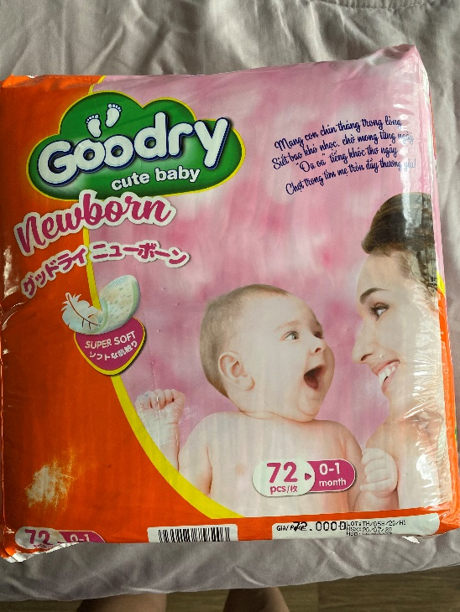
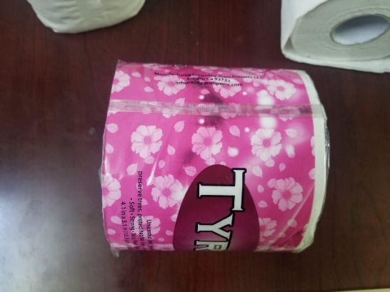
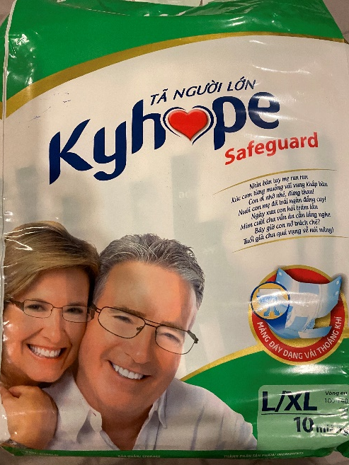
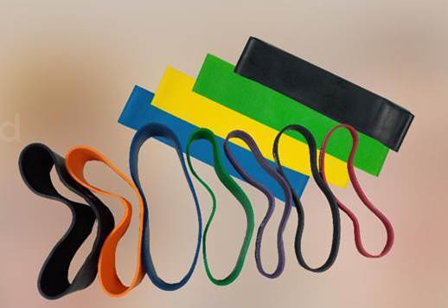
CONSUMER PRODUCTS & EXCERSIZE RESISTANCE BANDS
Adult age care and Child care
Complete range of adult’s age care products such as diapers, incognizance protect disposable pants
New born to 24 kgs child care diapers & disposable pants
Toilet paper
Sanitizer wipes
In partnership with
Shark tower 3rd floor
29, Nguyen Van Mai Street, Ward 8
District 3, Ho Chi Minh City
Tel : +84933296202
Tel : +94776331147 (whatsapp/viber)
Email : Marguerite.Aluwihare@net-glo.com
www:Net-Glo.com
3, Greenslope Street,
Wentworthville NSW 2145, Australia
Tel : +61469049451
Email : panjan.navam@gmail.com

Slide 6
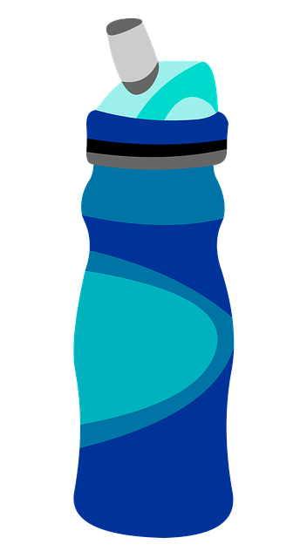
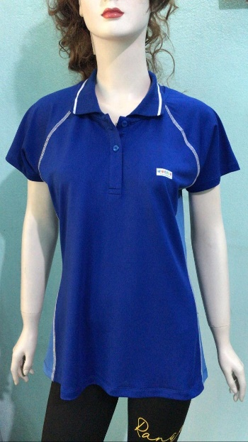
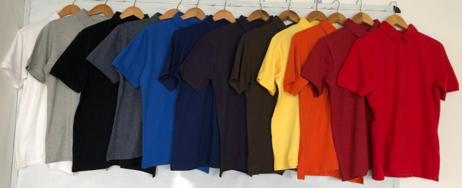
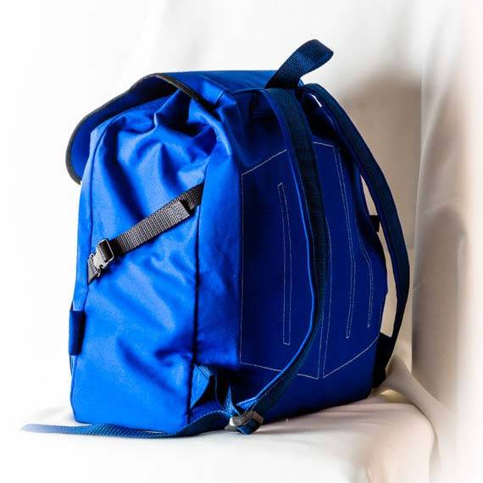
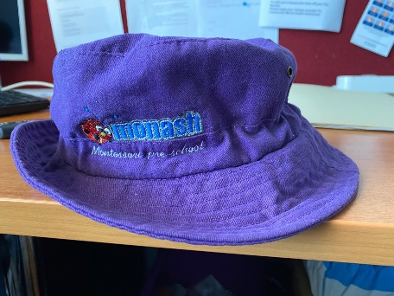
UNIFORMS, SPORTS TEAM OUTFITS, SCHOOL BAGS, WATER BOTTLES, SPORTS GEAR BAGS, HATS & CAPS
Uniforms
Branded shirts, T-shirts
Sports Team outfits
Branded equipment : Gifts, team identity, promotional material
School bags, sports bags, tote bags, beach bags
Branded shopping bags – Polypropylene (biodegradable)
Eco friendly shopping bags
Re-usable, sustainable shopping bags with branding
Water bottles
Hats & caps with branding
Terms & conditions apply
Orders – MOQ’s apply.
Smaller orders accepted on availability of fabric stock/ex stock
In partnership with
Shark tower 3rd floor
29, Nguyen Van Mai Street, Ward 8
District 3, Ho Chi Minh City
Tel : +84933296202
Tel : +94776331147 (whatsapp/viber)
Email : Marguerite.Aluwihare@net-glo.com
www:Net-Glo.com
3, Greenslope Street,
Wentworthville NSW 2145, Australia
Tel : +61469049451
Email : panjan.navam@gmail.com

Slide 7
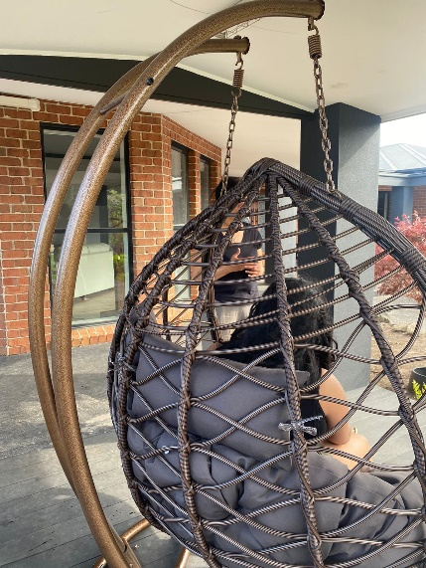
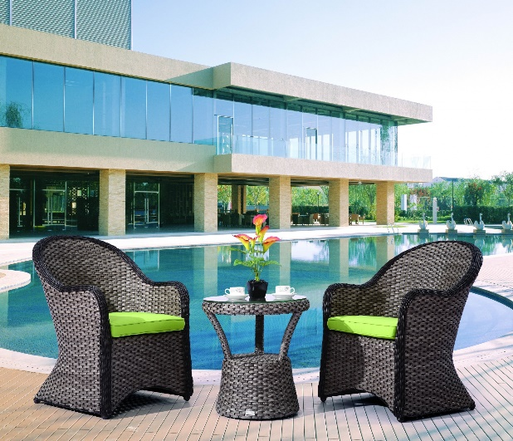
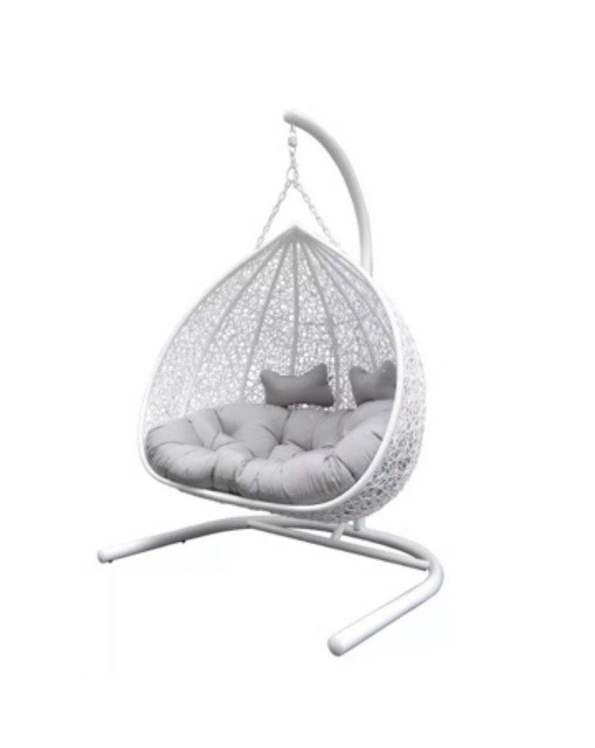
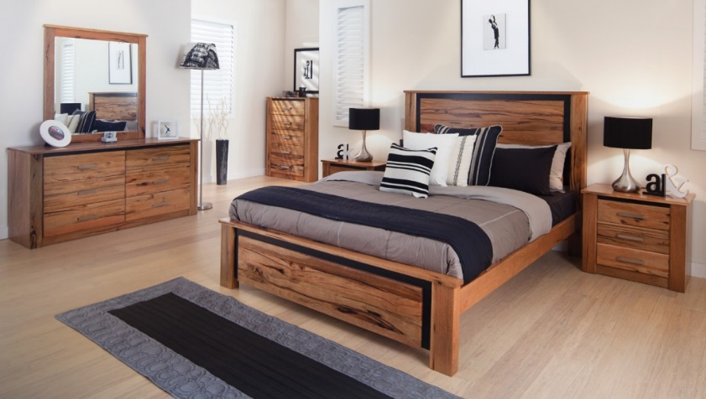
OUT DOOR & INDOOR FURNTIURE
Rattan garden and pool furniture
Egg shaped outdoor chairs
Rattan outdoor dining, pool, garden furniture
Indoor
Dining sets
Bedroom suites
Stand alone book racks, cabinets, corner
pieces
In partnership with
Shark tower 3rd floor
29, Nguyen Van Mai Street, Ward 8
District 3, Ho Chi Minh City
Tel : +84933296202
Tel : +94776331147 (whatsapp/viber)
Email : Marguerite.Aluwihare@net-glo.com
www:Net-Glo.com
3, Greenslope Street,
Wentworthville NSW 2145, Australia
Tel : +61469049451
Email : panjan.navam@gmail.com

